Slide 1
The Free Response Question
Disturbing …
but not
Threatening!

Slide 2
Start at the beginning…
Directions: You have 75 minutes to answer all three of the following questions.
It is recommended that you spend approximately one-third of your time (25 minutes) on each question.
It is suggested that you take up to 5 minutes of this time to plan and outline each answer.
While a formal essay is not required, it is not enough to answer a question by merely listing facts.
Illustrate your answers with substantive geographic examples where appropriate.
Be sure that you number each of your answers, including individual parts, in the answer booklet as the questions are numbered below.

Slide 3
The Approach!
Read the statement/ question
Determine what the question is asking you to answer
Make a brief list of topics that you will answer in your response… remember to do this quickly since you have a short time to answer all 3 of the questions

Slide 4
Maps! A Spatial Visual
Is there a map? make sure it is the map for the question
Assess the TODALsIG’s quickly: title, orientation, date, author, legend, index and grid as applicable
Assess what the question is asking you to determine from the map?
Is the map a tool?
Or is the question asking you for information off of the map? Refer to the map in your answer
, specifically indicating points, places, areas

Slide 5
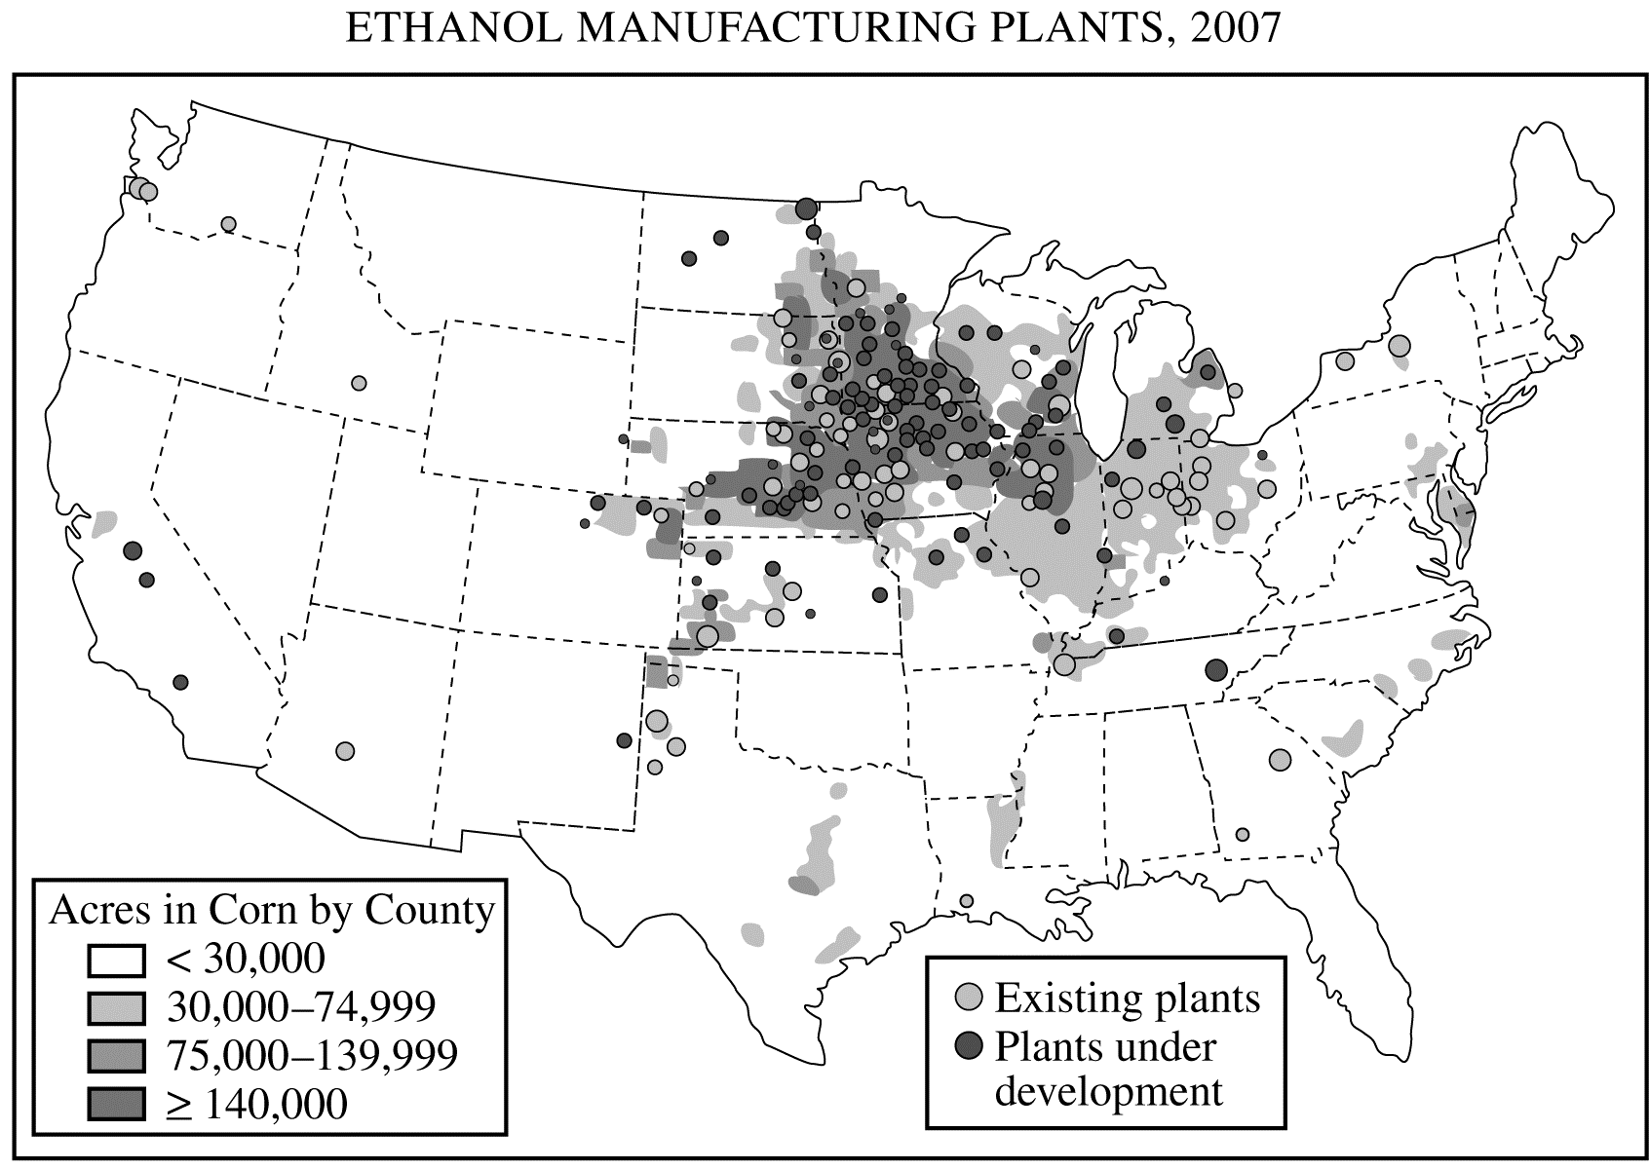
Read the Map!! What does it say?
title
date
legend
legend

Slide 6
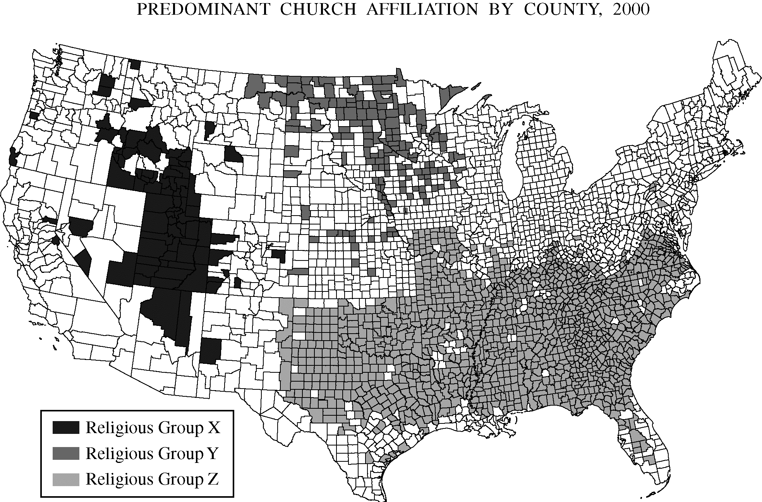
Map Scale… be careful!!

Slide 7
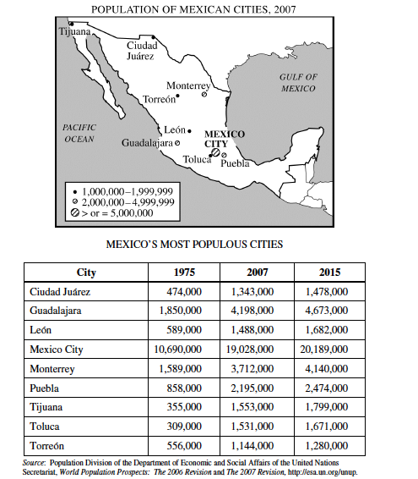
Does the Graph support the map? Are they co-dependent on each other?
Are they relevant to the question?
Maybe? Maybe Not??
Don’t be fooled!!!!
1. The map and table show the geographic location, population growth, and projected growth of Mexico’s
most populous cities.
A. Define the following terms and describe how each relates to Mexico’s urban geography.
• Primate city
• Rank-size rule
B. Explain TWO positive effects of primate cities on a country’s economic development and TWO different negative effects of primate cities on a country’s economic development.

Slide 8
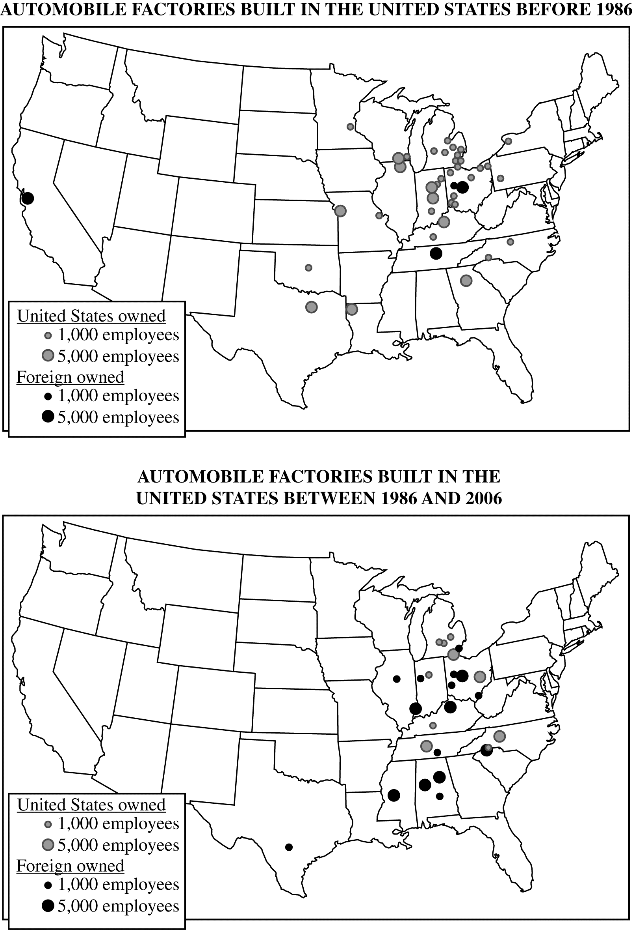
Industrial location models are used to explain geographic patterns of economic activity. The maps above show
automobile factories built before and after 1986 in the United States.
A. Identify TWO changes in the geography of automobile factory construction shown by the maps. (shifting locations)
B. Identify and explain TWO factors related to industrial location that may have contributed to the changes.

Slide 9
Housekeeping….
Construct your answer in the order of the prompt or...
Enumerate your answer if the question is a multi-part question and use the same enumeration!
If the question asks for examples… give an example and make it clear and specific to the question and area that is requested!
Do Not provide information that is not requested, leads off topic, is your personal opinion, you are not sure is valid and does not support the question.
Spell the Geographic terminology correctly!
Write concisely.
Think!! … You don’t have much time and the answer should not be much longer than a page.

Slide 10
Mental Triathalon…. (Jon Moore)
DEFINE: the term
EXPLAIN: the process
APPLY: to real world examples with accurate place names

Slide 11
What do they want me “To Do”
Analyze: Break down in order to bring out the essential elements or structure
Annotate: Add brief notes to a diagram or graph
Classify: Arrange or order by class or categories
Compare & contrast: Give an account of the similarities & Differences between two or more items or situations referring to both or all of them throughout
Construct: Display information in a diagrammatic or logical form
Contrast: Give an account of the differences between two or more items or situations
Define: Give the precise meaning of, for example, a word, phrase, concept or physical quantity
Describe: Give a detailed account
Determine: Obtain the only possible answer
Discuss: Offer a considered and balanced review that includes a range of arguments, factors, or hypotheses. Opinions or conclusions should be presented clearly and supported by appropriate evidence.
Distinguish: Make clear the differences between two or more concepts/ items

Slide 12
Draw: Represent my means of a labeled accurate diagram or graph using a pencil
Estimate: Obtain an approximate value
Evaluate: Make an appraisal by weighing the strengths and weaknesses
Examine: Consider and argument or concept in a way that uncovers the assumptions and interrelationships of the issue
Explain: Give a detailed account including reasons or causes
Identify: Find an answer from a number of possibilities
Justify: Give valid reasons or evidence for an answer or conclusion
Outline: Give a brief account or summary
Solve: Obtain the answer using numerical/ graphical methods
State: Give a specific name, value, or other brief answer without explanation or calculation
To what extent..: Consider the merits or otherwise of an argument or concept. Opinions and conclusions should be presented clearly and supported with empirical evidence and sound argument.

Slide 13
Psych out the Rubric!
Determine point value and progression of potential points awarded…
A: 2: 1+1
B: 2: 1+1
C: 2: 1+1
According to Alfred Weber’s theory of industrial location, three factors determine the location of a manufacturing plant: the location of raw materials, the location of the market, and transportation costs.
A. Using an example of a specific industry other than the one portrayed on the map above, explain under what conditions an industry would locate near the market.
B. Using an example of a specific industry other than the one portrayed on the map above, explain under what conditions an industry would locate near raw materials.
C. Using the map above and Weberian theory, explain the geography of ethanol plants in the United States.

Slide 14
Determine point value and progression of potential points awarded…
A: 4: 2+1+1
B: 4: 2+1+1
2. In 1798 Thomas Robert Malthus published An Essay on the Principle of Population in which he argued that population growth will inevitably outpace food production, resulting in widespread famine.
A. Identify and explain TWO reasons why some geographers today believe Malthus’ theory can be used to predict future population issues.
B. Identify and explain TWO reasons why some geographers today believe Malthus’ theory cannot be used to predict future population issues.

Slide 15
Use Geographic Terminology in the Answer!! Duh!!
industrial location
manufacturing plant
raw materials
Location
Market
transportation costs
industry
Economic development
Ethnicity
Transportation infrastructure
national identity
State
Population
Demographic
demographic transition model
explain the geography
Distribution
Religious
Contiguous
Scale
Urban
Megacities
Periphery
world system
Squatter settlements.
rapid growth
social,
economic
political
environmental
Agriculture
projected trends
organic farms
dairy farms
2009, 2010 exams

Slide 16
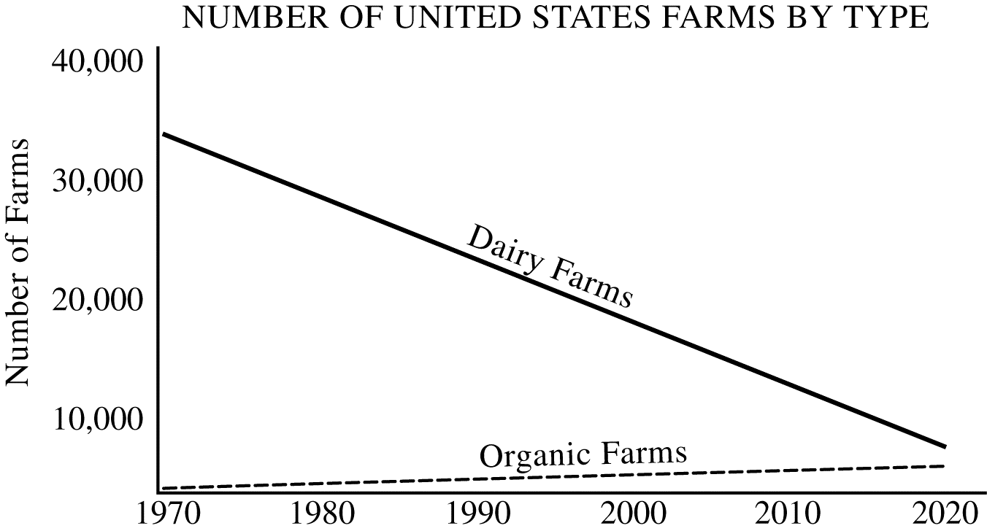
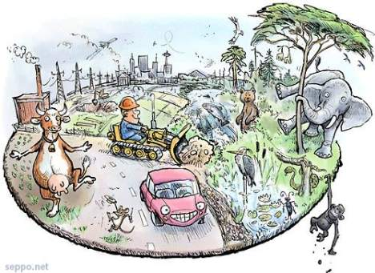
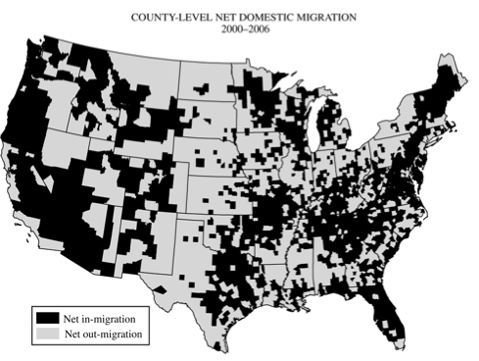
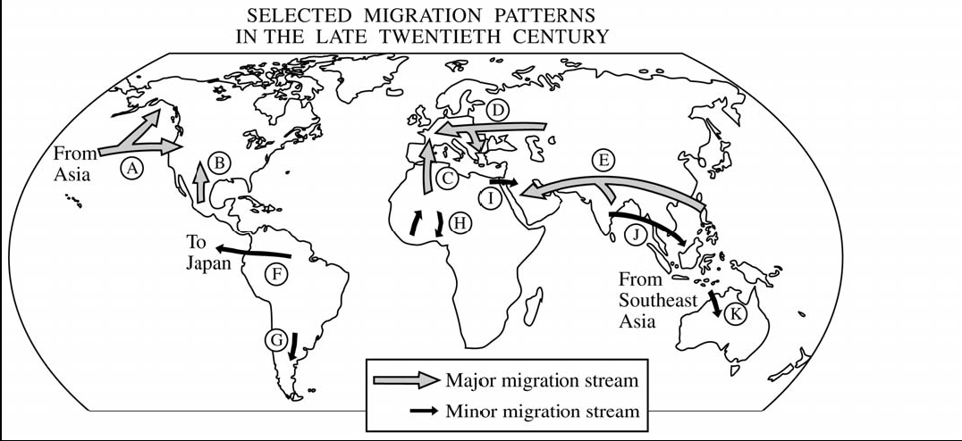
It’s a SPATIAL Subject!
2009
2008
2006

Slide 17
Operational creeping….
Question #1 is NOT and does NOT lead to #2 or #3
Previously used FRQ’s are NOT continued on future exams
Rewording of previous FRQ’s is NOT done
Operational questions are NOT used on the alternate exams at any time

Slide 18
Geo-Political Events!
Space: distribution, place, impact location of major world events
Time: chronology of major world events
= spatial impact = implications

Slide 19
Content overlap…

Slide 20
Watch the Language!
Adjectives & Modifiers:
Kills vs. decreases
Cheap labor vs. low labor costs
Up, down, right, left vs. north, south, east, west

Slide 21
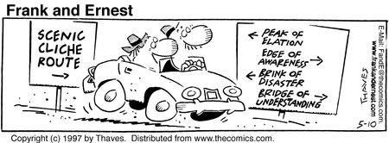
Is my answer Geographic?

